Slide 1
Oracle EBS: Buy/Sell Subcontracting
John M. Conlin CPIM
Principal Solutions Consultant, Value Chain & Manufacturing Applications

Slide 2
<Insert Picture Here>
Buy/Sell Subcontracting
A business practice where an Original Equipment Manufacturer (OEM) completely outsources the manufacturing of an assembly by buying the assembly from a Manufacturing Partner (MP) and sells the components (used to build the assembly) to the MP.
Notes:
So let’s get into the details of the Buy/Sell Subcontracting feature.

Slide 3
Subcontracting Glossary of Terms - 1
Original Equipment Manufacturer(OEM): Equipment manufacturer who Outsources the production of assembly to third party.
Manufacturing Partner(MP): Third party, manufacturing the assembly using the components supplied by the OEM
Outsourced Assembly: Assembly Item, designed by the OEM and manufactured by MP at MP’s site using OEM supplied Components
Subcontracting Components: Components sent by the OEM to MP for the manufacturing of Outsourced Assembly
Subcontracting Order: Purchase order (Standard or Release) created by the OEM to procure Outsourced Assemblies from MP
Notes:
Most of the terms are self explanatory and industry standard, however we will review some important terms used in the Subcontracting solution
Original Equipment Manufacturer: Most commonly referred to as OEM, who owns the design of the complete product , purchases raw materials and outsourcers subassemblies in the process of manufacturing the final Assembly. In some cases OEM may outsource final assembly to a third Party.
Manufacturing Partner: Also referred to as MP, performs the production of subassembly or final assembly for the OEM, with OEM supplied components
Outsourced Assembly: Can be a subassembly or final assembly manufactured by MP at his premises with the OEM supplied components
Subcontracting Components: are Lower level components of the outsourced assembly. OEM ships these components to MP for manufacturing the Outsourced assembly
Subcontracting Order: is a Normal purchase order shipment or release, created for procuring Outsourced Assemblies being Manufactured at MP’s site

Slide 4
Subcontracting Glossary of Terms - 2
Replenishment PO: Purchase Order created for MP in the Subcontracting Process to procure Subcontracting Components from the OEM. This is not visible on the User Interface. Also PO is closed for invoicing
Replenishment SO: Sales Order created in the Subcontracting Process to ship Subcontracting Components to MP
Replenishment Order: Term used in User Interface to represent Replenishment Sales order of Subcontracting Components
Allocations: Hard pegging of Replenishment SO’s created in the OEM organizations with the Component requirements for the Manufacturing of outsourced assemblies at MP Site
Notes:
Replenishment Purchase Order: is a regular Purchase Order for procuring the Subcontracting Components for MP from the OEM
Replenishment Sales order : is a Normal Sales Order with Subcontracting component at Line level. OEM ships the components to MP using this replenishment order
Allocations : In Subcontracting solution replenishment sales orders created for shipping the components to MP are pegged to components required at MP’s site for manufacturing the Assembly. This hard pegging is termed as Allocations and are done for component planning and tracking at MP’s site

Slide 5
Subcontracting Glossary of Terms - 3
Interlock : One of the processes used to automatically create the Demand at the MP (PO) and Supply at the OEM (Sales Orders) for the components to be sent by the OEM to the MP. This process also creates the component allocation to the Subcontract orders
Auto Receive Components: The process that automatically receives components at the MP based on in-transit lead times
Process Receiving Transactions: The process that, at Assembly receipt in the OEM, completes the simulated WIP job at the MP and issues out assembly to adjust the on hand quantity at MP
Notes:
Interlock, Auto receive Components and Process receiving Transactions are the important Concurrent programs in Subcontracting solution.

Slide 6
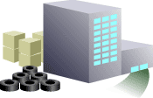
Subcontracting Business Process
RMS
MP added value = $5
MP
B
C
A
Place Order for B&C
2 Ea
1 Ea
Place Order for Outsourced Assembly A
B
C
B
C
Buy @ B -$2, C-$3
Buy Assembly A @ $ 19 (including $14)
Ship Components @ B-$4, C-$6
A
RMS: Raw Material Supplier
OEM : Original Equipment Manufacturer
MP: Manufacturing Partner
OEM
Pay to MP $5 [$19 – (2*$4 + 1*$6)]
Notes:
In Subcontracting business practice there are usually 3 parties involved.
The OEM, who Manufactures the final assembly,
The MP an outsourcing partner of OEM to Manufacture Subassemblies/final assembly and
The RMS Supplying Components to OEM.
IN the illustrated example on this slide
A is an assembly made out of components B&C. OEM Buys components B&C from RMS and Outsources the assembly A to MP
OEM places a Purchase order for Components , and buy components B and C from RMS
then OEM Places a Subcontracting Order for outsourced assembly A on MP, and Ship components B&C to MP
But OEM Still owns the materials till they are consumed in the Manufacturing of assembly A, So MP doesn’t explicitly pay for the Components.
MP Produces the assembly A from the components B&C and
Ship the assemblies to OEM. OEM Receives the assembly A , assumes that Components B&C are brought back from MP.
In this practice Purchase price of the Assembly includes components sales price and Value addition , OEM nets the Payables and receivables and pays the value addition to the MP

Slide 7
Subcontracting Solution Overview
Inventory Organizations
A
MP
OEM
2 Ea
1 Ea
Component Receipts and Assembly Completions are done by automatic processes
B
C
Subcontracting Order for Procuring Assembly A
Receive Assembly on Subcontracting Order
A
A
Manufacturing is simulated by Discrete job
Ship Components by Sales Order
B
C
Manufacturing
Notes:
Subcontracting Solution is developed for OEMs. In this Solution OEM and MP are modeled as inventory organizations
OEM places a subcontracting order on MP for Manufacturing the Assembly A.
At this moment Subcontracting solution triggers a sales order in OEM for shipping the components
Also a discrete job is created in MP automatically for simulating the manufacturing of assembly A.
OEM receives the assembly A from MP against subcontracting order and a batch program completes the Discrete job in MP .
All the inventory transactions in MP are automated and OEM doesn’t have to execute them manually

Slide 8
Subcontracting Major Features
MP Organizations are used for Planning and Tracking inventory at Supplier site
Supports Pre-positioned and Synchronized Components
Fully Integrated with Advanced Supply Chain Planning (ASCP)
Discrete job is created in MP for every subcontracting order in OEM for execution
Fully Allocate Components and Track on hand inventory
Automatic Receipts of Components in MP organization
Automatic completion of WIP jobs in MP organization
AP/AR Netting to make Payments to MP
Notes:
Major Features in Subcontracting solution are:
Manufacturing partner is modeled as an inventory organization to simulate production of assemblies . Accounting Transactions in MP are not posted to GL, hence the simulation of MP organization doesn't have any financial impact
Supports two different component types Pre-positioned and Synchronized based on the component replenishment methods for flexible modeling the subcontracting process.
ASCP plans the component requirements and supply, both in OEM and MP organizations in tandem.
Discrete jobs in MP organizations help in simulating production of assemblies at MP site
Component shipments in OEM organization are automatically allocated for better material control
Based on the in transit Lead times Components shipped in OEM organization are automatically received into MP organization for inventory tracking.
On receipt of Assemblies in OEM organization ,a batch process completes assembly and performs backflush components in MP organization
AP/AR netting streamlines Payment process

Slide 9
Subcontracting Major Features
Workbench to track the component shipments and allocations to the subcontracting order
Workbench to track estimated component consumption by outsource assembly and adjust for over / under consumption at the MP
Drop ship Components from RMS to MP
Track component Inventory at MP site
Reconcile Subcontracting Order changes
Buyback excess Components from MP
Supports Discrete and Project Manufacturing
Notes:
Subcontracting Workbench UI provides easy to use search screens to track component shipments and allocations
The Workbench UI also provides screens to view the estimated component consumption for manufacturing a specific discrete Job in MP organization, and allows to change consumptions and allocations based on the actual values at MP site.
OEM can also drop ship components from RMS to MP
With the modeling of MP as inventory organization and simulating the Production of Assemblies as discrete jobs, OEM has better visibility and control on the Component inventory at MP site
Reconciliation feature enables OEM to automatically replan component shipments to MP and also replan discrete Job's in MP for accurate simulation
Unconsumed and obsolete components at MP site are returned to OEM as Sales order returns, to simulate buying components back from MP to adjust accounting books of OEM organization
Subcontracting solution enables OEM to outsource assemblies in both Discrete and Project Manufacturing environments

Slide 10
Subcontracting Benefits
Effectively manage and automate the execution of your subcontracting relationship with the Manufacturing Partner in both discrete and project manufacturing environments
Integrated planning for both OEM and MP
Supports Physical movement of Components from OEM to MP with documents
Subcontracting Workbench gives better visibility into Process execution
Drop ship components from RMS to MP directly to save Costs
Payment settlement is streamlined by AP/AR Netting
Notes:
Let us discuss some key benefits the solution provides to the OEMs
Subcontracting solution enables OEM for better planning and control of the components in both OEM and MP Organizations
Allows shipping of subcontracting components to MP with supporting documents like Packing Slip and Bill of lading conforming to the Legal requirements
Workbench UI helps in tracking Component shipments , allocations , and adjusting the inventory based on the actual consumptions for effective planning and control of Subcontracting process.
Allows OEM to drop ship components to MP directly from RMS to save costs
AP/AR Netting creates Payments automatically for the value addition by netting AP and AR invoices and simplifies the payment process

Slide 11
Subcontracting Setup and Process
SETUP
PROCESS
Enable Subcontracting Profiles
Create Subcontracting Orders for Outsourced assembly in OEM Organizations
Ship Replenishment
Sales Order in OEM Organization
Receive Components
Against Replenishment PO in MP Organization
Define Customers and Suppliers
Create WIP Jobs for
Assembly in MP Organization
Define OEM and MP
Organizations
Receive Assemblies against
Subcontracting orders
In OEM Organization
Create Replenishment
Purchase Orders for
Components in MP Organization
Define Assemblies
and Components
Complete WIP jobs and backflush components
in MP Organization
Define Accounting
Setup
Net AP/AR in OEM and
Make Payment to MP
Create Replenishment Sales Orders for
Components in OEM Organization
Define Shipping
Networks
Automatic Process
Notes:
The key setup steps are:
Enable Subcontracting Profiles to use Subcontracting and AP/AR netting features
Define Customers and suppliers to model OEM and MP respectively
Define OEM and MP as Organizations and Associate Customers and suppliers defined in the previous step
Define Components, Assemblies in both MP and OEM organizations
Define new Accounts , AR and OM transaction types for execution and accounting
Define shipping networks between OEM and MP and enable Subcontracting relationship
The process is then executed as follows:
ASCP buy planned orders in OEM organization are transferred to purchasing to create subcontracting order for Outsourced assembly .Alternatively Subcontracting orders can also be created manually
Run interlock concurrent program , which automatically creates
Discrete Job for Assembly in MP Organanization for simulating the production of outsourced assembly
Replenishment Purchase order in MP for procuring components from OEM
Replenishment Sales Order in OEM for shipping the components to MP
Ship confirm Replenishment Sales orders in OEM to ship subcontracting components to MP, Also create AR invoice after shipping
Run Auto receive Components program to receive the components in MP
Receive Assemblies in OEM against subcontracting order created in step1, ADS Pay on receipt creates AP invoice
Run Process receiving Transaction concurrent program, which automatically completes the WIP job and backflushes the components
Run netting batch , which nets AP and AR invoices and pays to the MP

Slide 12
Setup and Process
Notes:
Now let us discuss the setup and processes in Subcontracting

Slide 13
Subcontracting Setup and Process
SETUP
PROCESS
Enable Chargeable
Subcontracting Profiles
Create Subcontracting Orders for Outsourced assembly in OEM Organizations
Ship Replenishment
Sales Order in OEM Organization
Receive Components
Against Replenishment PO in MP Organization
Define Customers and Suppliers
Create WIP Jobs for
Assembly in MP Organization
Define OEM and MP
Organizations
Receive Assemblies against
Subcontracting orders
In OEM Organization
Create Replenishment
Purchase Orders for
Components in MP Organization
Define Assemblies
and Components
Complete WIP jobs and backflush components
in MP Organization
Define Accounting
Setup
Net AP/AR in OEM and
Make Payment to MP
Create Replenishment Sales Orders for
Components in OEM Organization
Define Shipping
Networks
Automatic Process
Notes:
The key setup steps are:
Enable Subcontracting Profiles to use Subcontracting and AP/AR netting features
Define Customers and suppliers to model OEM and MP respectively
Define OEM and MP as Organizations and Associate Customers and suppliers defined in the previous step
Define Components, Assemblies in both MP and OEM organizations
Define new Accounts , AR and OM transaction types for execution and accounting
Define shipping networks between OEM and MP and enable Subcontracting relationship
The process is then executed as follows:
ASCP buy planned orders in OEM organization are transferred to purchasing to create subcontracting order for Outsourced assembly .Alternatively Subcontracting orders can also be created manually
Run interlock concurrent program , which automatically creates
Discrete Job for Assembly in MP Organanization for simulating the production of outsourced assembly
Replenishment Purchase order in MP for procuring components from OEM
Replenishment Sales Order in OEM for shipping the components to MP
Ship confirm Replenishment Sales orders in OEM to ship subcontracting components to MP, Also create AR invoice after shipping
Run Auto receive Components program to receive the components in MP
Receive Assemblies in OEM against subcontracting order created in step1, ADS Pay on receipt creates AP invoice
Run Process receiving Transaction concurrent program, which automatically completes the WIP job and backflushes the components
Run netting batch , which nets AP and AR invoices and pays to the MP

Slide 14
Setup
• Setting up OEM Organizations
• Setting Up Manufacturing Partner Organizations
• Defining Customers and Suppliers
• Associating Customers and Suppliers
• Setting Up Item Definitions
• Setting Up Bills of Material for Outsourced Assemblies
• Defining Price Lists for Subcontracting Components
• Setting Up Purchase Price of an Outsourced Assembly
• Setting Up a Shipping Network
• Defining Sourcing Rules
• Defining Netting Agreements

Slide 15
Subcontracting Setup – Key Profile Options
JMF: Enable Subcontracting
This Profile should be set to ‘YES’ to use Subcontracting feature. This profile is updatable at site level only
Enable Subcontracting
This Profile should be set to ‘YES’ to include Outsourced assembly item invoices in AP/AR Netting. This profile is updatable at site level only
Notes:
If the user would like to enable Subcontracting , two profile options must be enabled. They are: JMF: Enable Subcontracting and Enable Subcontracting
Both profile options need to be enabled simultaneously at the site level. The JMF: Enable Subcontracting profile enables the OEM to model and execute subcontracting process. The ‘Enable Subcontracting ’ profile option enables a pop list (Select only Invoices matched to Purchase Orders with Outsourced Assemblies) on the netting agreement. We will see this in Part 2 of the presentation

Slide 16
Planning & Execution
Notes:
Let us discuss the Planning and execution of outsourced assemblies and components

Slide 17
Subcontracting Setup – Overview
Transfer to GL : Yes
OEM Organization
MP Organization
Transfer to GL : NO
Standard Costing
A
A
Organization Roles
Organization | Customer | Supplier
MP | √ | √
OEM |  | √
2 Ea
1 Ea
2 Ea
1 Ea
B
C
B
C
Item
Make/ Buy
Outsourced Assembly
Subcontracting Component
Supply Source
Item
Make/ Buy
Outsourced Assembly
Subcontracting Component
Supply Source
A
Buy
Yes
-
Buy From MP
A
Make
Yes
-
Make at MP
B
Buy
No
Synchronized
Buy from RMS
B
Buy
No
Synchronized
Buy from OEM
C
Buy
No
Synchronized
Buy from RMS
C
Buy
No
Synchronized
Buy from OEM
Shipping Networks
From Org | To Org
OEM | MP
MP | OEM
Notes:
We will discuss setup overview from planning and execution perspective
Define OEM and MP as Inventory Organizations with Standard costing. Only Standard costing is supported in R12.0
MP organization is a simulation organization, Accounting transactions will not be transferred to GL
Define Components and assemblies in both OEM and MP organizations
In Subcontracting Solution MP acts as both customer and supplier to OEM, and OEM acts as supplier of components from MP’s perspective
Define sourcing rules in OEM and MP organizations for planning
Define shipping networks between OEM and MP and establish Subcontracting relationship
Now we will see the details of each setup

Slide 18
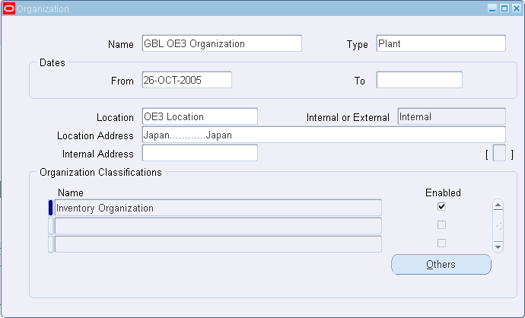
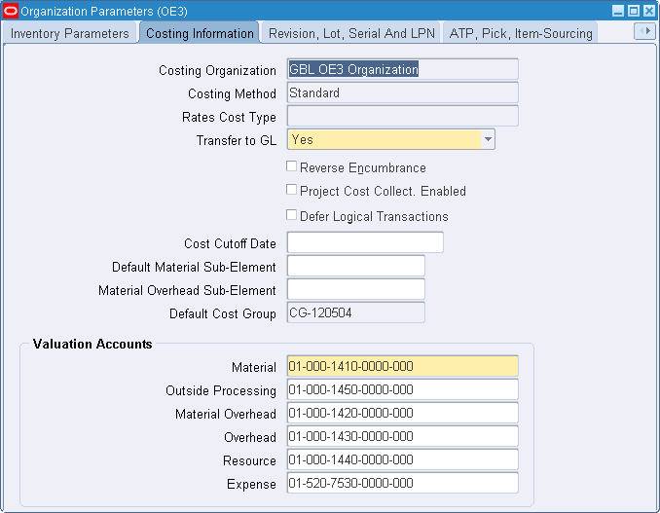
Subcontracting Setup – OEM Organizations
Accounting Transactions are Posted to GL
OEM Organization Location Country code should be Japan, Korea or Taiwan (Chargeable)
OEM Organization Costing method should be standard Costing (Chargeable)
Notes:
Navigation:
<Inventory : Setup : Organizations : Organizations>
Define OEM Organization with Location country code as Japan, Korea or Taiwan
OEM is a regular inventory organization, so set the Transfer to GL to Yes to post all accounting transactions to GL. Set Costing method as Standard . Only standard costing method is supported in the Release 12.0

Slide 19
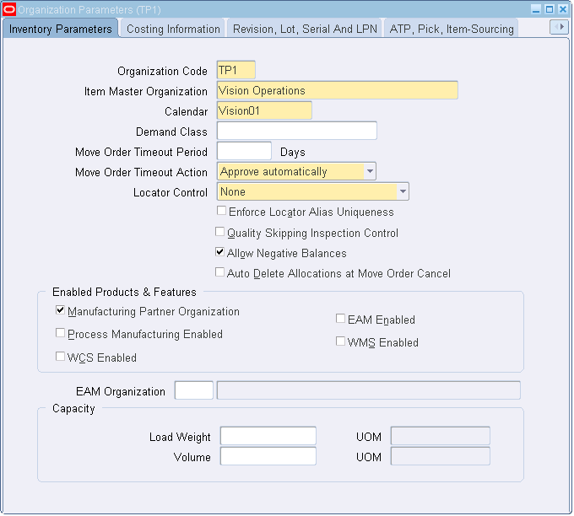
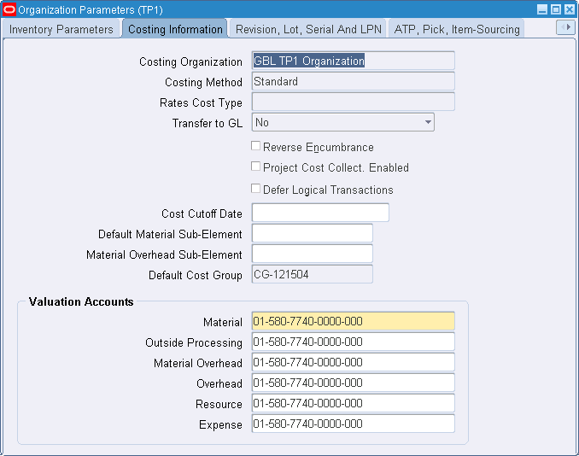
Subcontracting Setup – MP Organizations
Select Check box for Manufacturing Partner Organization
MP organization is simulation organization, Accounting transactions in this organization should not be transferred to GL
Notes:
Navigation:
<Inventory : Setup: Organizations : Parameters>
Define MP as inventory organization by checking the flag Manufacturing Partner in the Inventory parameters
In the Costing information tab, set Transfer to GL to “No”

Slide 20
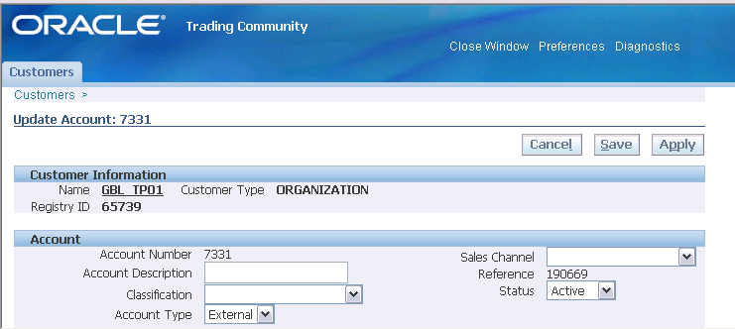
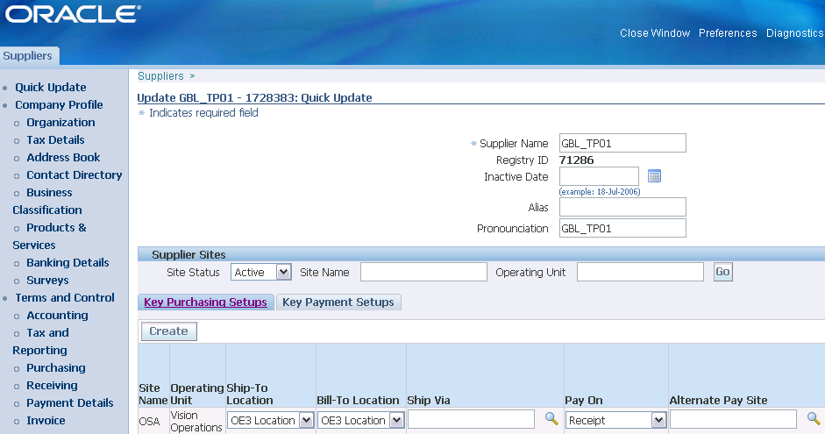
Subcontracting Setup – Define Customers/Suppliers
Define MP as Customer /Customer site
Define MP and OEM as Supplier / Supplier site
Notes:
Navigation:
Customers : <Order Management : Customers : Trading Community : Trading Community:Customers:Standard>
Suppliers : <Purchasing : Supply Base : Suppliers>
In Subcontracting Solution MP acts as both Supplier and Customer and OEM acts a Supplier
Define MP as customer /customer sites
Define Both MP and OEM as supplier/Supplier sites

Slide 21
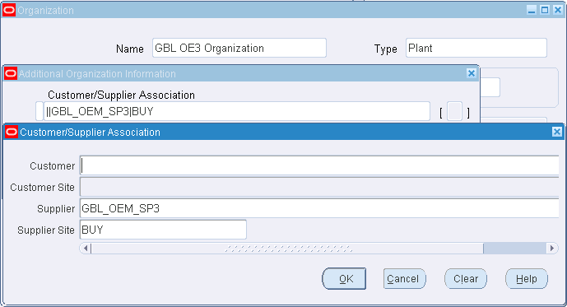
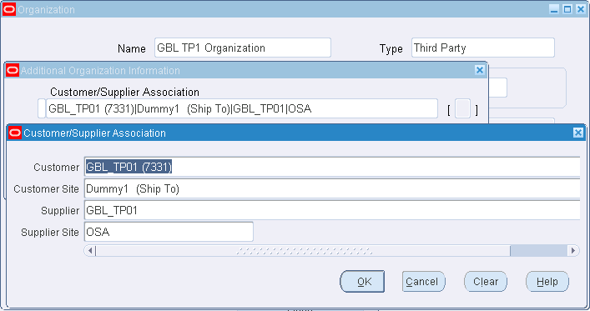
Subcontracting Setup – Customer/Supplier Association
OEM Organization
MP Organization
MP supply Assemblies, Procure Components from OEM and acts as both supplier and Customer
OEM supply components to MP and acts as supplier
ASCP uses this definition along with sourcing rules to plan outsourced assemblies and components in OEM and MP Organizations
Notes:
Navigation:
<Inventory : Setup : Organizations : Organizations/Inventory Organization/others/Customer Supplier Association >
In the Organizations Customer Supplier association form
For OEM Organization associate Supplier and supplier site defined for OEM in the previous slide
For MP Organization associate both , customer/customer site, Supplier/supplier site defined in the previous slide
This information is used in ASCP planning for transferring the net demands of assemblies and components between OEM and MP organizations

Slide 22
Subcontracting Setup – Item Definition
Define Items and Bills in OEM and MP Organizations
Outsourced Assemblies
Assemblies designed by OEM and manufactured at Manufacturing Partner site using components supplied by OEM
Subcontracting Components
Pre positioned
Components are shipped to MP without reference to any Subcontracting Order ahead of assembly requirements.
Synchronized
Components are shipped to MP with reference to a specific Subcontracting Order along with the order.
Notes:
Define Items as
Outsourced Assemblies and Subcontracting components and they should be identical between OEM and MP
Two types of Subcontracting components are supported
Pre positioned components are generally low cost items and OEM store these components in larger quantities at Manufacturing Partner site well ahead of ordering outsourced assemblies. These components are shipped to MP based on the ASCP Planning
Synchronized components are generally high cost items and are shipped when the order is placed on the Manufacturing partner and in the quantities needed to produce the outsourced assembly in the subcontracting order. Interlock Manager , a batch program in Subcontracting solution triggers the sales order for shipment of these components
These two types of components help OEMs to model the subcontracting Process in a flexible manner

Slide 23
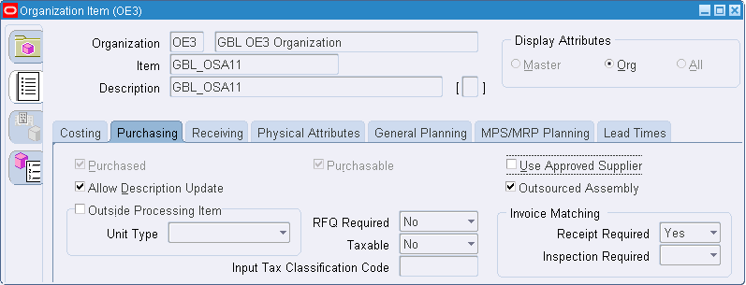
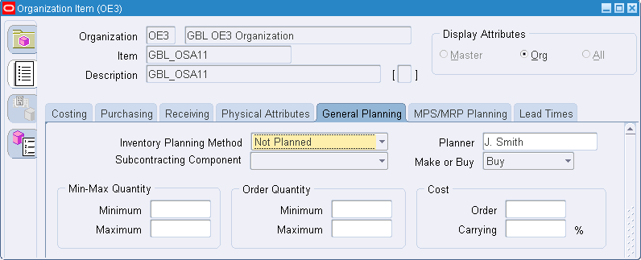
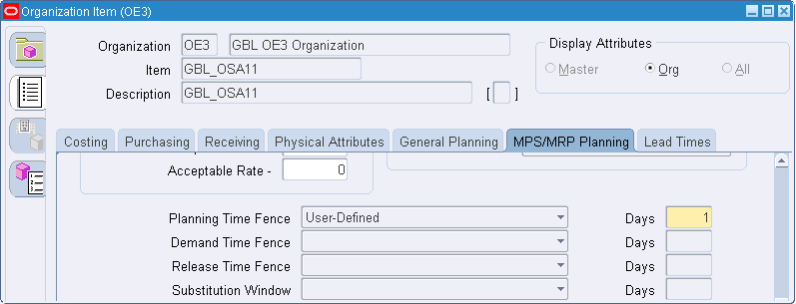
Subcontracting Setup – Outsourced Assemblies in OEM
OEM Organization
Check this for outsourced assembly, allowed only if the Profile JMF:Enable Subcontracting is Yes
Release Time Fence should be left blank. ASCP releases buy planned orders of outsourced assembly to Purchasing as Purchase orders/ Releases
Outsourced Assembly should be defined as Buy item for planning.
Routing can be defined for outsourced assembly in OEM
Notes:
Navigation:
<Inventory : Items : Organization Items>
Define Outsourced assembly items in OEM Organization
In the Purchasing Tab, check outsourced Assembly flag to define item as outsourced assembly
In the General Planning Tab, define outsourced assembly as Buy item.
In the MPS/MRP Planning tab, leave Release Time Fence as Blank. This allows the buy planned orders of assembly to be transferred as Purchase order or release in OEM organization
Outsourced assemblies can have routing in OEM organizations. OEM doesn’t have to change the existing routing setup to outsource the assembly

Slide 24
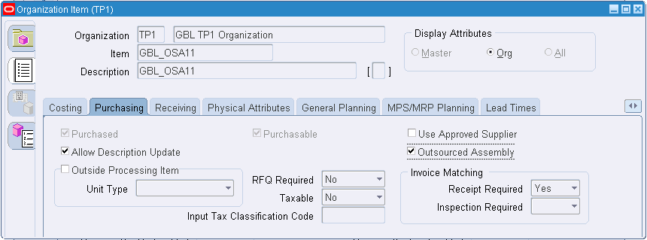
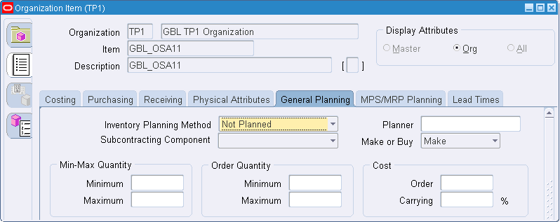
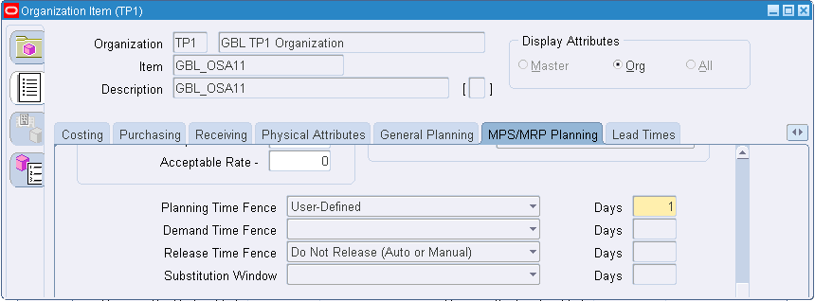
Subcontracting Setup – Outsourced Assemblies in MP
MP Organization
Check this for outsourced assembly, allowed only if the Profile JMF:Enable Subcontracting is Yes
Outsourced assemblies should be defined as Make items for planning
Release Time Fence should be “Do not Release Auto Or Manual”. ASCP should not release make planned orders of Outsourced Assemblies in MP.
Routing should not be defined for outsourced assembly in MP
Notes:
Navigation:
<Inventory : Items : Organization Items>
Also define Outsourced assembly items in MP organization
In the Purchasing Tab, check outsourced Assembly flag to define item as outsourced assembly
In the General Planning Tab, define outsourced assembly as Make item. Production of this Assembly is simulated in MP organization
In the MPS/MRP Planning tab, set Release Time Fence= “Don’t release auto or Manual”. This prevents make planned orders of assembly to be transferred as Discrete Jobs in MP organization. Interlock creates discrete jobs in MP organization, we will be discussing the details in the subsequent slides
Outsourced assemblies can’t have routing in MP organizations.

Slide 25
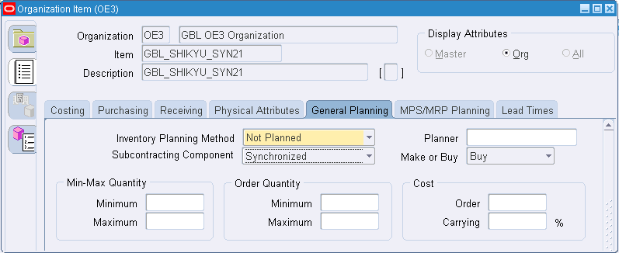
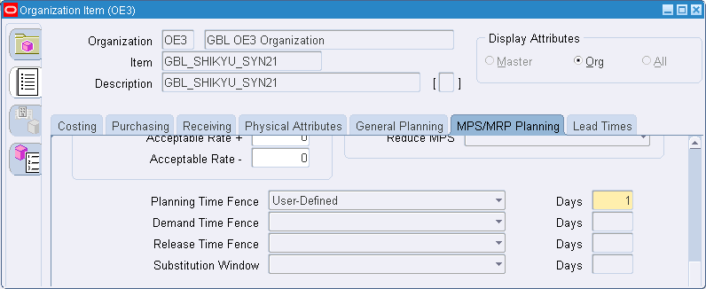
Subcontracting Setup – Subcontracting Components in OEM
OEM Organization
Subcontracting Component should be defined as either “Synchronized” or “Pre positioned”
Release Time Fence can be left blank. Planning releases buy planned orders to Purchasing as Purchase orders/ Releases
Notes:
Navigation:
- <Inventory : Items : Organization Items>
Define Components in OEM Organization
In the General planning tab define component as Synchronized or propositioned based on the subcontracting process requirement
In the MPS/MRP planning tab define Release Time fence as Null. This allows ASCP to release the planned orders of components as Purchase orders to procure from RMS

Slide 26
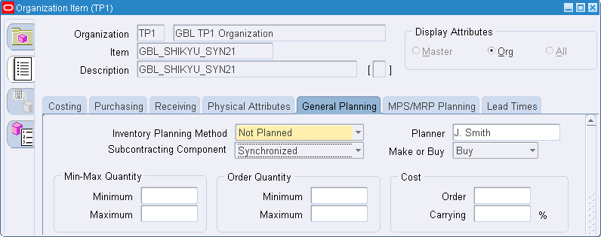
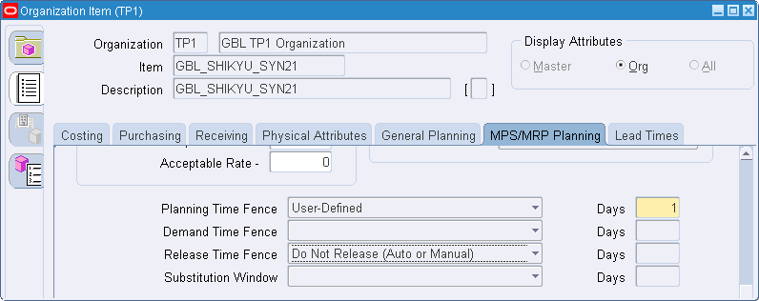
Subcontracting Setup – Subcontracting Components in MP
MP Organization
Subcontracting Component should be defined as either “Synchronized” or “Pre positioned”
Release Time Fence should be set as ,
“Do not Release Auto or Manual” for Synchronized components and Blank for Pre-positioned Components. ASCP Should not release planned orders of synchronized components in MP
Notes:
Navigation:
- <Inventory : Items : Organization Items>
Similarly in MP organizations define the components as synchronized or pre positioned
And set Release time fence
“Don’t release Auto or Manual” for Synchronized components
Null for Prepositioned components

Slide 27
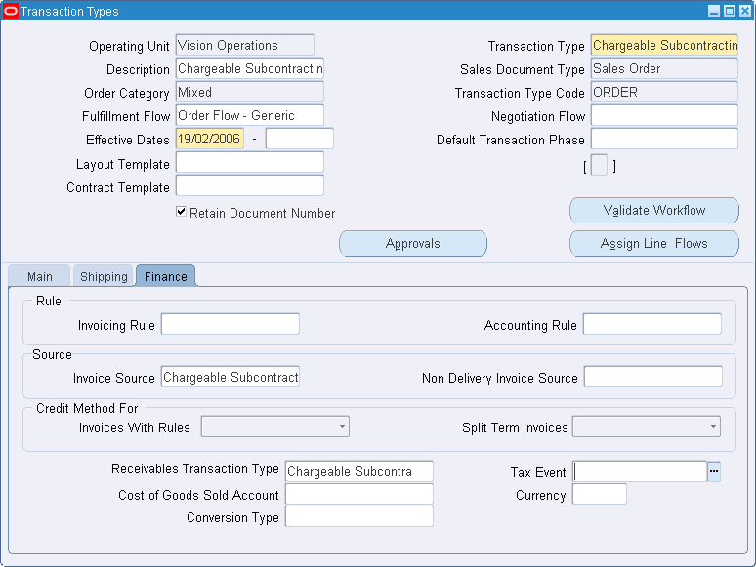
Subcontracting Setup – OM Transaction type
Create separate “Invoice Source” and “AR transaction type” and attach to this order type. This is required for accounting (Chargeable)
Create a separate order type, this will be used for creating Replenishment sales orders for component shipments to MP
Notes:
Navigation:
<Order Management : Setup : Transactions : Define>
Define new OM transaction type
Associate invoice source and receivable transactions to track Subcontracting specific accounting transactions. More details of these accounting setup will be discussed in the part2 of this presentation

Slide 28
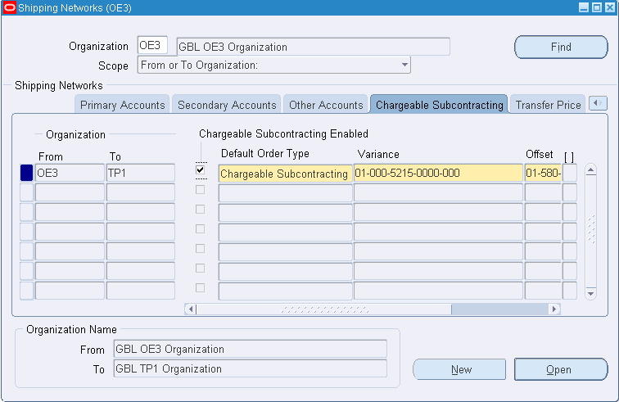
Subcontracting Setup – Shipping Networks
Select check box to define Subcontracting relationship between OEM and MP
Specify the order type to be used for creating replenishment sales orders to ship components to MP
OEM can have Subcontracting relationship with multiple MP’s
MP can supply different assemblies to Multiple OEMs
Notes:
Navigation:
<Inventory : Setup : Organizations : Shipping Networks>
Define Shipping networks between OEM and MP organizations by
Enabling Subcontracting relationship between them by checking Subcontracting flag .
Defining defaults order type , interlock manager in Subcontracting solution creates replenishment Sales orders with this order type for shipping the components to MP
In Subcontracting an OEM can outsource the same assembly from different Manufacturing partners

Slide 29
Subcontracting Setup – Sourcing
OEM Organization
MP Organization
A
A
2 Ea
1 Ea
2 Ea
1 Ea
B
C
B
C
Item | Make/ Buy | Supply Source
A | Buy | Buy From MP
B | Buy | Buy from RMS
C | Buy | Buy from RMS
Item | Make/ Buy | Supply Source
A | Make | Make at MP
B | Buy | Buy from OEM
C | Buy | Buy from OEM
RMS: Raw Material Supplier
ASCP uses the Sourcing rules for creating Make or Buy Planned orders
Notes:
Define sourcing rules and assignments in OEM and MP organizations for planning
In OEM organization define the sourcing rules to “ Buy components from RMS” and “buy Assembly from MP”
In MP Organization Define the sourcing rules to “Buy Components from OEM” and “Make assembly in MP”
ASCP creates Make/buy planned orders based on these sourcing rules

Slide 30
Subcontracting Process – Planning Synchronized Components
OEM Organization
MP Organization
Forecast
B&C are Synchronized Components
A
A
A
None
A is a Buy Item, No BOM Explosion
A
Net requirement of A as a demand to MP
A
A is a Make Item, BOM is exploded
Planning run
2 Ea
1 Ea
B
Net requirement of B as a demand to OEM
B
C
Net requirement of C as a demand to OEM
C
Planned Orders
A
Buy
B
Buy
C
Buy
A
Make
B
Buy
C
Buy
×
×
×
Descrete Job / Purchase Order
A
Buy from MP
B
Buy from RMS
C
Buy from RMS
In Organization Items , Release Time fence = “Don’t release Auto or Manual” for Items A,B & C, Planned orders can’t be released
Notes:
Let us discuss the planning of assemblies and components in OEM and MP organization. After setting up the date, run ASCP Collections to transfer them from Oracle instance to Planning instance . Then create plans and necessary Setup in ASCP. In our example Assembly A consists of all synchronized components
Define Forecast for Assembly A in OEM organization
Launch ASCP plan. Some of the key details of ASCP planning are
Netted requirement of A in OEM organization is passed to MP organization as a demand for A. This is done based on the Sourcing rules and the customer supplier associations defined in the Organizations. Since A is a buy item in OEM organization, BOM will not be exploded to calculate gross requirements of components. In MP organization A is a Make item and its BOM is exploded , and net requirements of components are calculated considering the inventory and purchase orders of the components in MP
Net requirements of components B&C are passed as demand to OEM and the component requirements are netted in OEM based on this demand
Make and Buy planned orders are created for the components and assemblies in OEM and MP organizations
In OEM Buy Planned orders of Assembly A and Components B&C are transferred as Standard Purchase Orders or Release based on the Setup. In MP organization Planned orders can’t be released due to the Release Time Fence set as “Don’t release auto or manual “ in Organization items

Slide 31
Subcontracting Process – Execution Synchronized Components
OEM (Standard Cost Org)
MP (Zero Cost Organization)
Pay to MP
$
A
AP/AR Netting
B&C are Synchronized Components
2 Ea
1 Ea
AP Invoice
AR Invoice
B
C
SHIP
Receive
Replenishment SO Item : B , QTY:20Ea Customer: MP
Replenishment PO Item : B, QTY:20Ea Supplier : OEM
No Manual Transactions in MP Org
SHIP
Receive
Replenishment SO Item : C, QTY:10Ea Customer : MP
Replenishment PO Item : C, QTY:10Ea Supplier : OEM
Misc Issue A
ASCP
Subcontracting Order Assembly : A , 10Ea Supplier : MP
Discrete Job Assembly : A QTY :10Ea
Receive
Complete
Interlock
Auto receive Components
Process Receiving Transactions
Notes:
Changeable subcontracting Process execution starts with the Subcontracting order of Assembly A Created by ASCP. You can also create these Subcontracting Orders Manually
Run interlock Manager for OEM organization. This Batch program picks the Subcontracting order and creates discrete job automatically in MP Organization for simulation.
This Program then calculates the Component requirements and creates approved Replenishment Purchase orders in MP for procuring the components from OEM
Then interlock creates Replenishment Sales orders with status booked in OEM for the corresponding Replenishment Purchase Order in MP. Replenishment Sales order in OEM is created with OM transaction type defined in Shipping networks and have one to one relationship with the replenishment Purchase orders in MP. Finally these replenishment Sales orders are hard pegged to the discrete job requirements in MP and this hard pegging is termed as allocations.
You can then ship Replenishment Sales orders of the components in OEM
Run Auto receive Components Program for MP organization. This Batch program picks up the shipped replenishment Sales orders in OEM Organization, and create Receipts against the corresponding Purchase order in MP .
MP Manufactures and ships the assembly to OEM and OEM receives the assembly against a subcontracting order
Process Receiving Transactions Program picks the Subcontracting order receipts in OEM and completes the corresponding discrete Job and performs backflush components in MP organization. This program also creates a misc issue to reduce the inventory of assembly in MP org to simulate Assembly shipments to OEM
You can run Auto invoice Master program in Receivables to create AR invoice automatically for the shipped components
Run Pay on receipts auto invoice program to create AP invoice for the assemblies received.
These AP and AR invoices are netted in the financials and the payment is made to MP for the value addition

Slide 32
Subcontracting Process – Planning Prepositioned Components
OEM
MP
Forecast
B is Prepositioned C is Synchronized
A
A
A
None
A is a Buy Item, No BOM Explosion
A
Net requirement of A as a demand to MP
A
A is a Make Item, BOM is exploded
Planning run
2 Ea
1 Ea
B
Net requirement of B as a demand to OEM
B
C
Net requirement of C as a demand to OEM
C
Planned Orders
A
Buy
B
Buy
C
Buy
A
Make
B
Buy
C
Buy
×
×
In Organization Items Release Time fence = “Don’t release Auto or Manual” for A and C, Planned orders can’t be released
Descrete Job / Purchase Order
A
Buy from MP
B
Buy from RMS
C
Buy from RMS
B
Buy from OEM
Notes:
Let us take assembly with both prepositioned and synchronized components and discuss the planning of prepositioned components . We will take an Assembly A with both prepositioned and synchronized components and understand the planning process
Create forecast for A
Launch ASCP to plan for components and assembly in MP organization.
B is a Pre positioned component and C is a Synchronized component. Netted demand of Assembly A is passed to MP organization
Netted demand of Components are passed to OEM organization
ASCP creates planned orders for Components and assembly in both OEM and MP organization. Up to this point the planning process is absolutely the same for pre positioned and synchronized components
The main difference is in transferring the planned orders in MP organization. Planned orders of pre positioned component B can be transferred to MP as replenishment Purchase order, but Planned orders of synchronized component C can’t be transferred. This is a basic difference due to Release time fence setup for Pre positioned and Synchronized components in Organization items

Slide 33
Subcontracting Process – Execution Prepositioned Components
OEM (Standard Cost Org)
MP (Zero Cost Organization)
Pay to MP
$
A
AP/AR Netting
B is Prepositioned C is Synchronized
2 Ea
1 Ea
ASCP
AP Invoice
AR Invoice
B
C
SHIP
Receive
Replenishment SO Item : B , QTY:100Ea Customer: MP
Replenishment PO Item : B, QTY:100Ea Supplier : OEM
No Manual Transactions in MP Org
SHIP
Receive
Replenishment SO Item : C, QTY:10Ea Customer : MP
Replenishment PO Item : C, QTY:10Ea Supplier : OEM
Misc Issue A
ASCP
Subcontracting Order Assembly : A , 10Ea Supplier : MP
Discrete Job Assembly : A QTY :10Ea
Receive
Complete
Interlock
Auto receive Components
Process Receiving Transactions
Notes:
In case of Assemblies with Prepositioned components, the Subcontracting Process execution starts with Replenishment Purchase orders of the pre positioned components. These replenishment orders are created by transferring ASCP Planned orders .
Interlock picks these replenishment Purchase orders in MP and creates corresponding replenishment sales orders in OEM .
Interlock then picks the Subcontracting orders in OEM organization and creates discrete job for assembly , replenishment PO for synchronized components in MP organization .
Interlock then creates corresponding replenishment Sales order for synchronized components in OEM organization and creates component allocations for both pre positioned and synchronized components.
You can then ship Replenishment Sales orders of the components in OEM
Auto receive Components Program receives components automatically in MP organization.
OEM receives the assembly from MP
Process Receiving Transactions Program completes the discrete Job and performs backflush components, and creates a miscellaneous issue of assembly A in MP organization.
You can run Auto invoice Master program to create AR invoice
Run Pay on receipts auto invoice program to create AP invoice for the assemblies
Finally Net AP and AR invoices and make payment to MP.

Slide 34
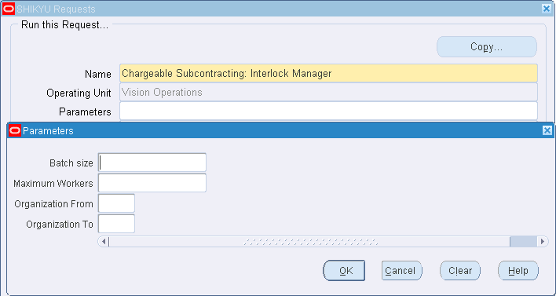
Subcontracting Process – Interlock Manager
Range of OEM Organizations
Identify unprocessed Replenishment Purchase orders in MP and create Replenishment Sales Orders in OEM
Identify unprocessed Subcontracting Orders in OEM and create
Discrete Jobs in MP
Replenishment Purchase Orders in MP for synchronized components and corresponding Replenishment Sales orders in OEM
Allocations for component requirements in MP
Notes:
Navigation:
<Subcontracting : Requests/Subcontracting : Interlock manager>
Let us look at the three key concurrent programs in Subcontracting solution that helps in simulating the production of assemblies in MP organization
The first one - Interlock Manager picks
Replenishment Purchase orders in MP organization and creates replenishment Sales orders in OEM
Subcontracting Orders in OEM organization and creates discrete jobs, replenishment POs in MP organization and replenishment Sales orders in OEM and finally makes allocations

Slide 35
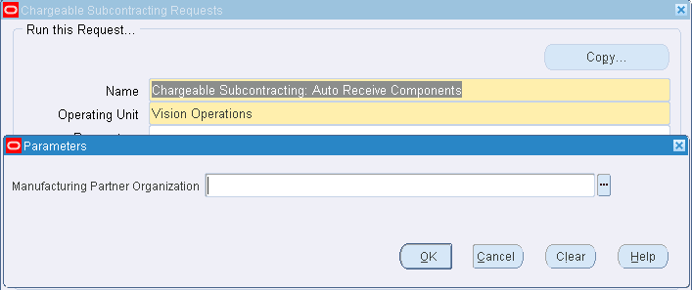
Subcontracting Process – Auto Receive Components
MP Organization for which Subcontracting components to be received automatically
Identify the unprocessed replenishment Sales Order shipments in OEM organization
Create Receipts for the corresponding Replenishment Purchase Order in MP
Replenishment sale orders which are shipped and due to be received in MP organization are considered for processing
Default Shipment Lead times in Shipping networks are considered
Notes:
Navigation:
< Subcontracting : Requests/Subcontracting: Auto receive Components >
Auto receive Components concurrent Program Picks the shipped replenishment Sales orders in OEM organization based on the MP organization given in the concurrent request parameters
This program then creates component receipts for the corresponding purchase orders in MP organization . This Program will only pick the Shipped sales orders which are expected to be received in MP organization after considering the In-transit Lead time defined in the shipping networks.

Slide 36
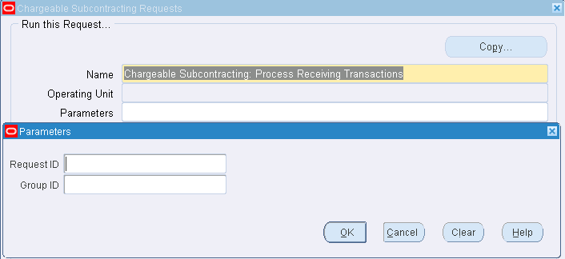
Subcontracting Process – Process Receiving Transactions
Identify unprocessed Assembly Receipts in OEM organization
Complete WIP job and backflush components in MP organization
Misc. issue of assembly in MP Organization
Identify unprocessed Assembly returns in OEM Organization
Misc Receipt of Assembly in MP Organization
Return WIP job in MP Organization
Identify Unprocessed Component returns in OEM organization
Create RTV for the component in MP Organization
Notes:
Navigation:
< Subcontracting : Requests/ Subcontracting: Process receiving Transactions >
Process receiving transactions concurrent Program
Picks Assembly receipts in OEM organization and triggers WIP job completion and Misc issues to adjust inventory in MP org
This program also Processes Assembly returns, receipts and return corrections of assemblies and also component returns in OEM

Slide 37
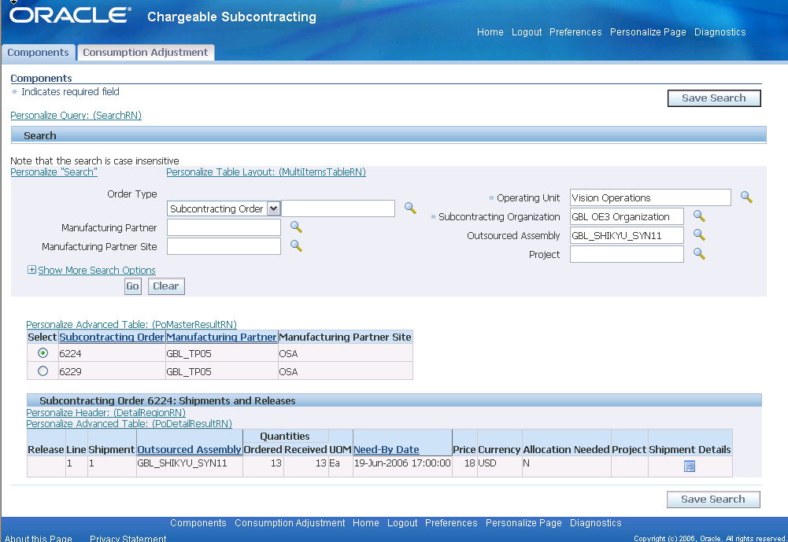
Subcontracting Process – Workbench-Subcontracting Orders
On the Workbench User can search subcontracting Orders and verify the receipts
Subcontracting order headers of Outsourced Assembly
Subcontracting order line shipment or releases
Details of the Components to be shipped to MP
Notes:
Navigation:
<Subcontracting>Workbench>Components>
Workbench UI provides easy to use search screens to view Subcontracting orders, replenishment orders and helps in taking appropriate action for better control of subcontracting Process
On the Components Page you can search and view Subcontracting orders by Manufacturing Partner or by Assembly. Incase of Project Manufacturing, you can also search and view the subcontracting orders by project
These subcontracting orders are regular purchase orders shipments /releases created for outsourced assemblies, you can see the header details on UI.
Subcontracting order lines contain the details of the outsourced assembly ordered on MP. Discrete job created in MP organization is associated with Subcontracting order line shipment.
Details of the components required for manufacturing the discrete job can be viewed on the shipment details page .Click Shipment details icon to navigate to shipment details page

Slide 38
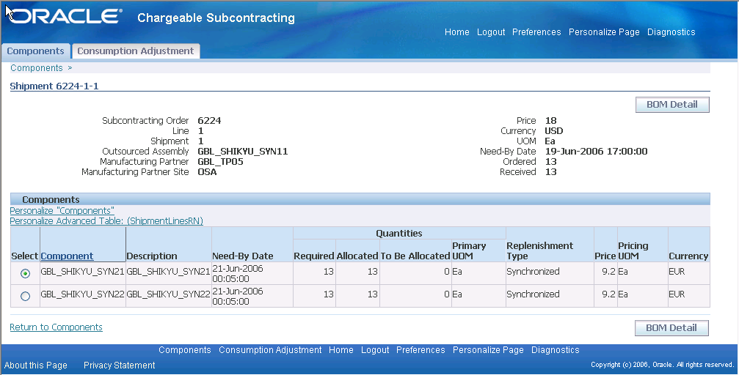
Subcontracting Process – Workbench-Components
Components to be shipped to MP for making assembly of a specific subcontracting order .
To drilldown to the BOM components of the assembly
User can see the components requirement quantity and date for manufacturing the assembly at MP site
Notes:
Navigation:
- <Subcontracting>Workbench>Components:Shipment >
Shipment Details page shows the components to be shipped by OEM to MP for manufacturing the assembly.
Click on the BOM details button to view the current BOM details of outsourced assembly. On clicking this button , Bill Of Material form is opened with component details

Slide 39
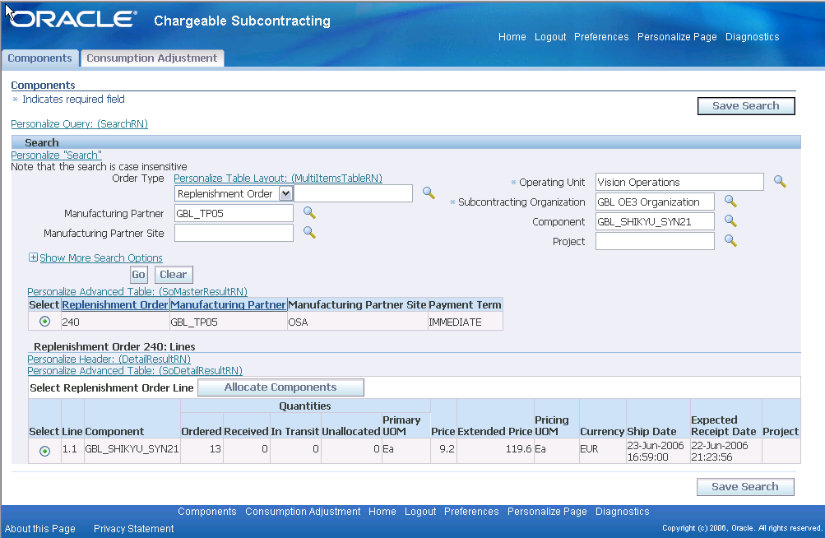
Subcontracting Process – Workbench-Replenishment Orders
On the Workbench User can search Replenishment Orders
Replenishment Sales Order Headers
View and create Component Allocations
Replenishment Sales Order Lines
Notes:
Navigation:
< Subcontracting>Workbench>Components>
On the Components Page you can also search and view replenishment Orders created in the OEM organization for shipping the components to MP. You can search the replenishment orders by MP, or by Component and by Project
Search results are displayed as Replenishment order headers
On selecting the specific order you can view the Replenishment Sales order lines for shipping the components. Incase of synchronized components, the replenishment order is allocated to a single discrete job requirement and in case of pre positioned components, replenishment order is allocated to multiple discrete job requirements.
Click on the allocation button for viewing the allocation details

Slide 40
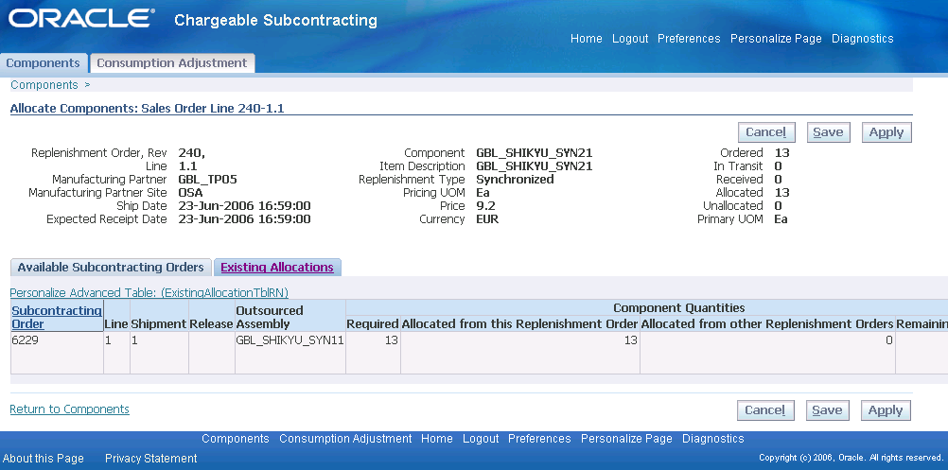
Subcontracting Process – Workbench-Allocations
Allocation details of a specific replenishment Order
Existing Allocations tab
Details of the subcontracting orders hard pegged
Allocations is hard pegging of replenishment Sales order quantity in OEM with discrete job component requirements in MP
Allocations indicates components shipments to MP organization for Manufacturing specific subcontracting Order
Allocations are always made up to the requirement quantity only
Notes:
Navigation:
<Subcontracting>Workbench>Components:Allocate components>
On the allocations Page you can view existing allocations created automatically by interlock and also create allocations. Incase of synchronized components, replenishment orders are always created for the required quantity of the discrete job associated to a subcontracting order. These replenishment orders are always fully allocated. In case of pre positioned components, replenishment order are created well ahead of requirements and is allocated periodically for the requirements of the several subcontracting orders; these orders may have some unallocated quantity.
In the existing Allocations tab, you can view the details of the subcontracting orders allocated to the current replenishment Order

Slide 41
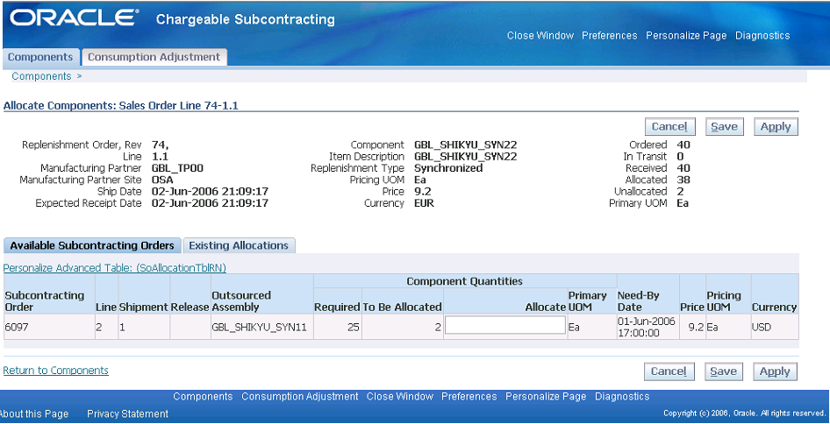
Subcontracting Process – Workbench-Allocations
Replenishment order component pegging summary
Available Subcontracting Orders tab
List of subcontracting orders needing component allocations
Enter the quantity and create Manual allocations
Synchronized components are always fully allocated. This UI is meant for making allocations in exceptional situations for pre positioned components
Notes:
Navigation:
- <Subcontracting>Workbench>Components:Allocate components>
In case of replenishment sales orders of pre positioned components, there will be some unallocated quantity . If some of the pre positioned components of the discrete job assocociated with the subcontracting order are not fully allocated , due to some exceptional reasons ,you can manually allocated them in this page.
In our example replenishment sales order is having 2 units of unallocated quantity which can be allocated to subcontracting orders
In the allocations tab we have one subcontracting order needs 2 units of allocation
Enter quantity to allocate in the box and click on apply button to create allocations .

Slide 42
Thank You
Thank You
Notes:
This concludes Part 1 of the Subcontracting presentation which covers Planning and Execution. Please advance to the Part 2 for Financial accounting and settlement in Subcontracting

