Slide 1

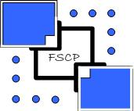

What’s New in R12?
What really matters in the changes

Slide 2
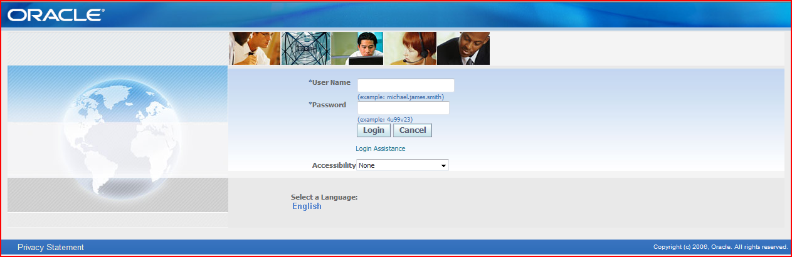
What is new

Slide 3
What is new and where
FSCP Solutions Inc.
Overall
General Ledger
  Subledger Accounting (SLA)
E-Business Tax
Accounts Payable
Accounts Receivable
Fixed Assets
Cash Management

Slide 4
and here too
FSCP Solutions Inc.
Purchasing
Cost Management / Inventory
Bills of Material
Quality
Service
WIP
eAM

Slide 5
Overall changes
FSCP Solutions Inc.
Responsibilities span multiple Operating Units for transactional capability
Legal Entity has now become relevant
UMX – User Management has a implicit role in some tasks
New User Interface
  Multiple forms are now Java/HTML based; often the application jumps between these
XML Publisher - now BI Publisher is now the default publishing mechanism

Slide 6
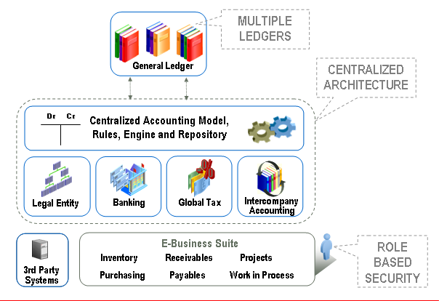
R12 Architecture Overview
FSCP Solutions Inc.
NorCalOAUG Training Day - August 24th, 2012
6
Notes:
6

Slide 7
R12 – “Global Business Release”
FSCP Solutions Inc.
Announced in 2007 as the “Global Business Release”
  Multi-Org Access Control
  Ledger Sets
  Primary and Secondary Ledgers
  Rules-Based Accounting Engine (Subledger Accounting)
  Shared Use of Customers, Vendors
  New Bank and Bank Account Model
  New Payment Processing
  Rewritten / Shared Tax Engine
  Financial Services Hub
  Common Assets Repository

Slide 8
General Manufacturing Improvements
FSCP Solutions Inc.
Better Manufacturing Demand Planning & Execution
  Demantra (Demand Planning) Integrated to SC Planning
  Manufacturing Execution Systems (MES) for Discrete & Process
Global MFG Improvements
  Enhancements to support VMI, Contract MFG
  Enterprise Supply Chain Planning and Costing
  OSFM, Flow and Quality Enhancements

Slide 9
General Ledger
FSCP Solutions Inc.
Set of Books have become Ledgers
  with Ledger, Data Access and Definition Access Sets
Legal Entity has become an important aspect of the setup process
You need to assign/link a Ledger to a Legal Entity
Subledger Accounting (SLA) is inherent to the GL design

Slide 10
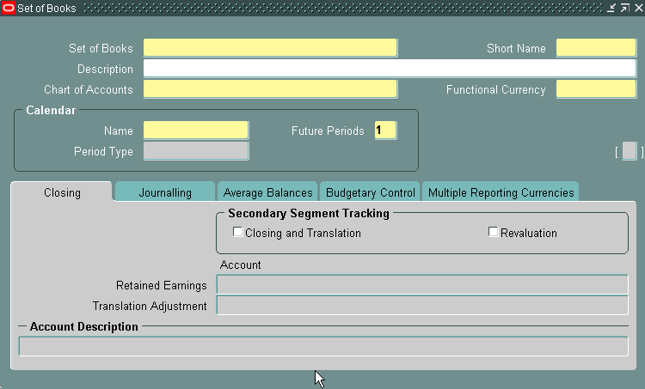
Old Set of Books Define Form
FSCP Solutions Inc.

Slide 11
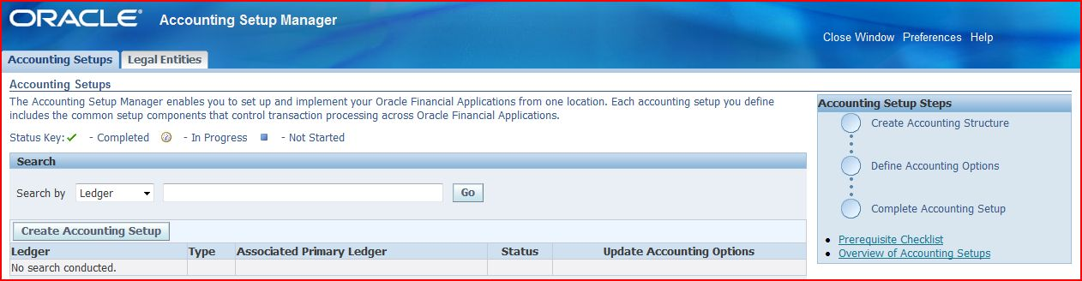
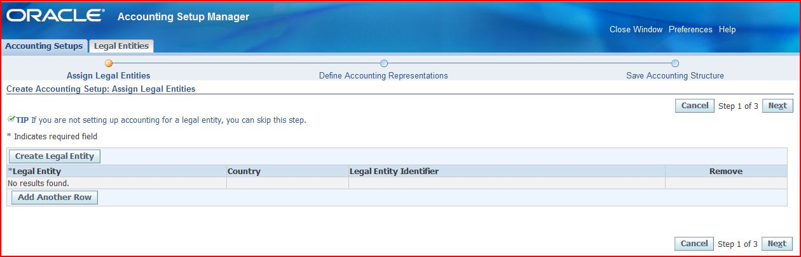
New Ledger Define Form
FSCP Solutions Inc.

Slide 12
What you should know
FSCP Solutions Inc.
You have to start with creating a Legal Entity to start a Ledger definition
You cannot use the same name for a Legal Entity
The key is the Tax ID Number (cannot be re-used)
You cannot delete these from the system
  you can end-date them

Slide 13
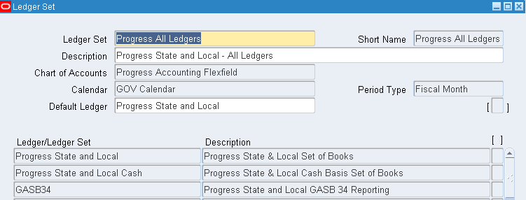
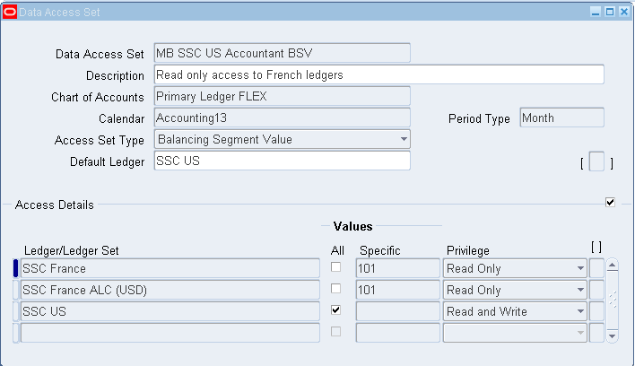
Ledger & Data Access Sets
FSCP Solutions Inc.
Ledger Set
Data Access Set
NorCalOAUG Training Day - August 24th, 2012
13

Slide 14
Definition Access Sets
FSCP Solutions Inc.
Allows securing functionality within GL
Specific tasks are managed by this (short list)
  Mass Allocation definitions
  Recurring Journal Formulas
  Financial Statement Generator components
Securing access capabilities
  Use
  View
  Modify
NorCalOAUG Training Day - August 24th, 2012
14

Slide 15
R12 Multi-Org Access Control
FSCP Solutions Inc.
Mostly affects “operating unit” level functions
Allows you to access information across multiple operating units without changing responsibilities
Set up a security profile to access the operating units
Run Security List Maintenance concurrent program
Assign the security profile using the MO: Security Profile
Allows the move to Role Based Security Control (RBAC)

Slide 16
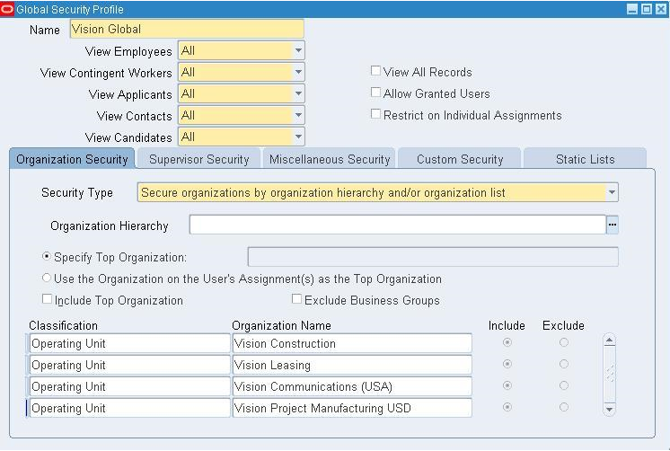
R12 Multi-Org Access Control
FSCP Solutions Inc.

Slide 17
Security Inconsistencies
FSCP Solutions Inc.
Inventory Org Access and MOAC is not Consistent
You Can Access an Inventory Org that
  Belongs to an Operating Unit you cannot access
  Belongs to a Ledger you cannot access
Inventory Org Forms Work Differently Than OU Forms
  Cost Mgmt INTL => Go to Operational Analysis => Purchases => Purchase Orders => Purchase Orders
  Try to access the US Operating Unit -- NOT ALLOWED
  Yet you can access any US inventory organization-based forms
  OU Based: any PO, A/P, Order Management, A/R forms
  Inventory Org Based: INV, CST, BOM, WIP, MRP, Receiving forms

Slide 18
Financials – Accounting Setup Manager
FSCP Solutions Inc.
The Accounting Setup Manager is a central location to define your accounting related setup across all financial applications
  Define your legal entities and their accounting context
  Which ledgers
  Multi-Org setup
  Centralizes your setup and makes it easier to inquire on and maintain relationships between ledgers, legal entities, and operating units.

Slide 19
Subledger Accounting (SLA)
FSCP Solutions Inc.
SLA as this is commonly called is now everywhere!
This has become the gateway to GL from all other modules
All accounting entries are created in the SLA – before coming into GL
Create Accounting is the process to create accounting entries - everywhere
Notes:
Note: Periodic Costing in Oracle Cost Management does not use SLA

Slide 20
E-Business Tax
FSCP Solutions Inc.
A new Tax Engine has been added to the multitude of modules
This now manages tax calculation for all application modules
It has to be setup independently and has its own setup steps
One still needs to connect/contract with a service provider for the Tax Rates

Slide 21
Accounts Payable
FSCP Solutions Inc.
Accounts Payable has gone a retrofit change on the Invoice and Payment functions
There is additional region - Lines - between the Header and the Distribution
The FA Book Name can be identified on the distribution and line level
Payment Manager is a new concept for Payment processing

Slide 22
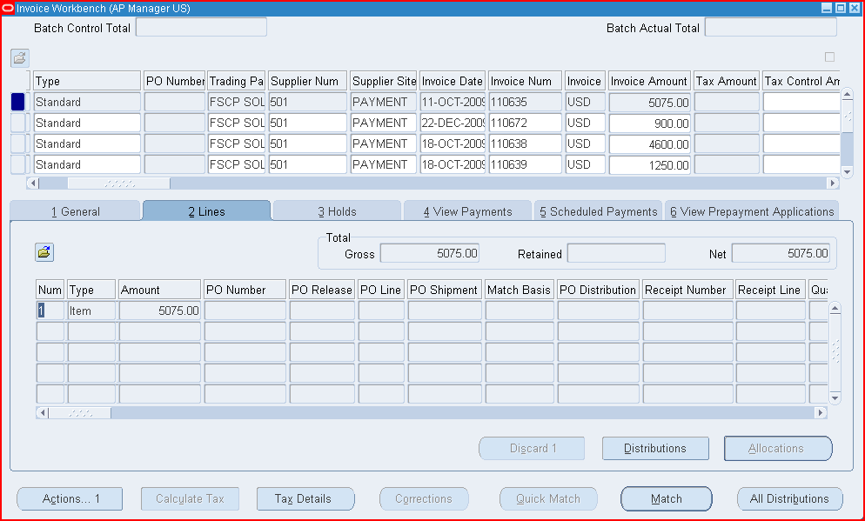
New AP Invoice Form
FSCP Solutions Inc.

Slide 23
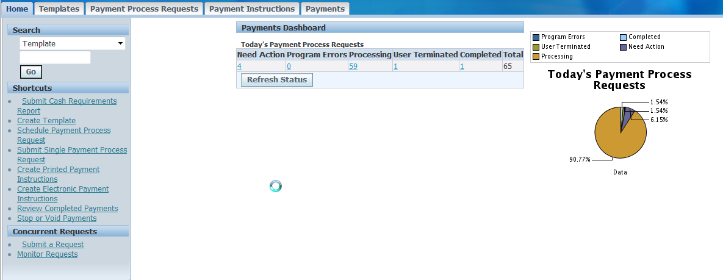
New Payments Dashboard
FSCP Solutions Inc.
NorCalOAUG Training Day - August 24th, 2012
23

Slide 24
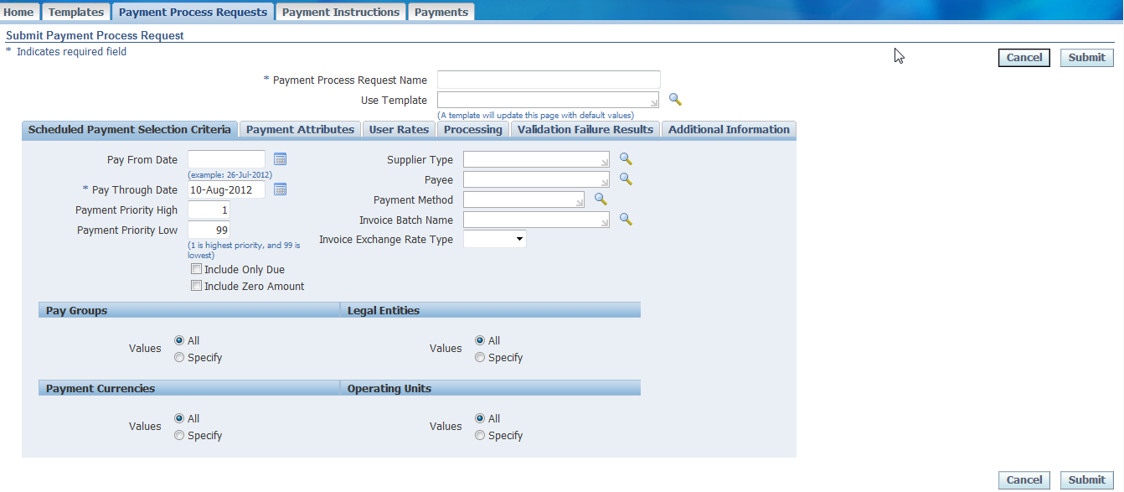
New Payments Dashboard
FSCP Solutions Inc.
NorCalOAUG Training Day - August 24th, 2012
24

Slide 25
Accounts Receivable
FSCP Solutions Inc.
Major change is the COGS and Revenue Recognition matching – happens simultaneously
However, you can now apply receipts to a line on an AR Invoice
Customer form has changed drastically
The Customer form has been moved to the TCA architecture

Slide 26
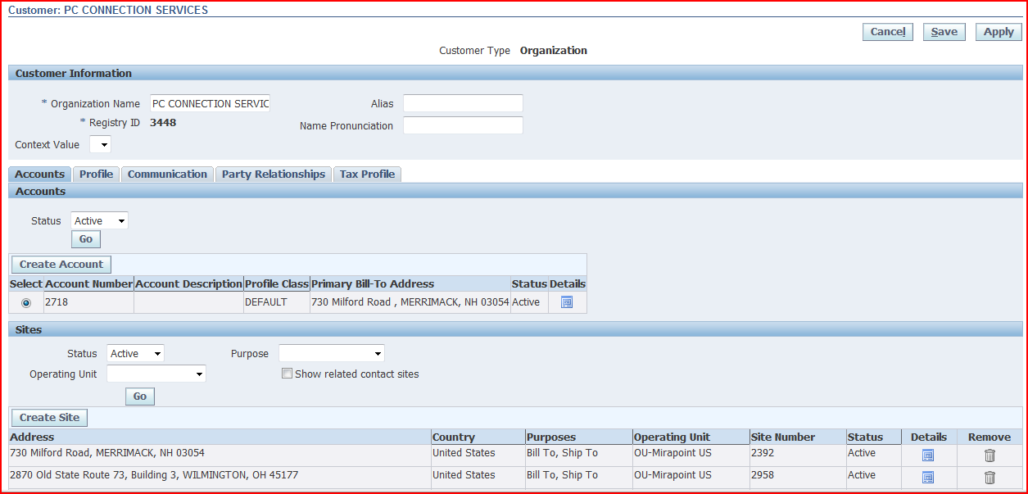
New Customer Form
FSCP Solutions Inc.

Slide 27
Fixed Assets
FSCP Solutions Inc.
You can now make changes to an Asset and the system will automatically roll-back depreciation for that asset
R11i: You can separately run depreciation without closing the F/A accounting period
You can then run “Create Accounting” multiple times

Slide 28
Cash Management
FSCP Solutions Inc.
Cash Management now “owns” Banks!
You need to log in to Cash Management to create Bank and Account Information
You MUST assign the Cash Management responsibility using UMX – User Management
This MUST be done using the SYSADMIN User, not the responsibility!

Slide 29
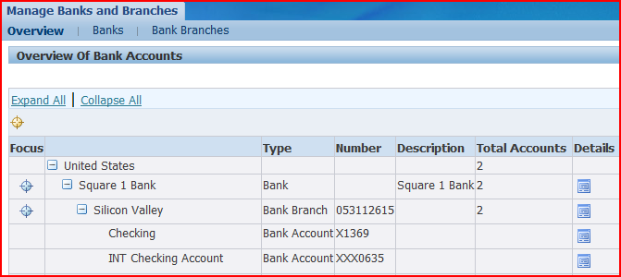
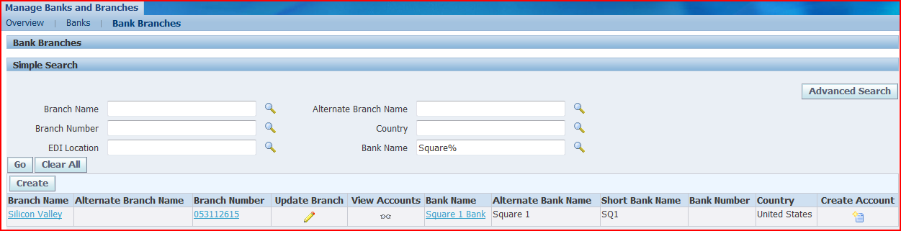
Banks in Cash Management
FSCP Solutions Inc.

Slide 30
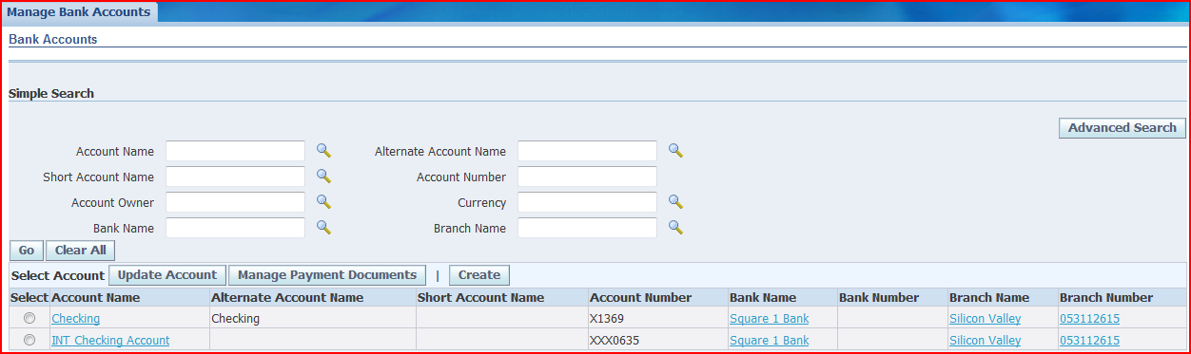
Banks in Cash Management
FSCP Solutions Inc.

Slide 31
Purchasing
FSCP Solutions Inc.
Vendors are now part of TCA
Form has changed considerably and is not the same as the Customer form!
Common Catalog for Purchasing and iProcurement and are combined
Advanced Pricing in Purchasing now allows you to model complex pricing rules on Global Blanket Agreements

Slide 32
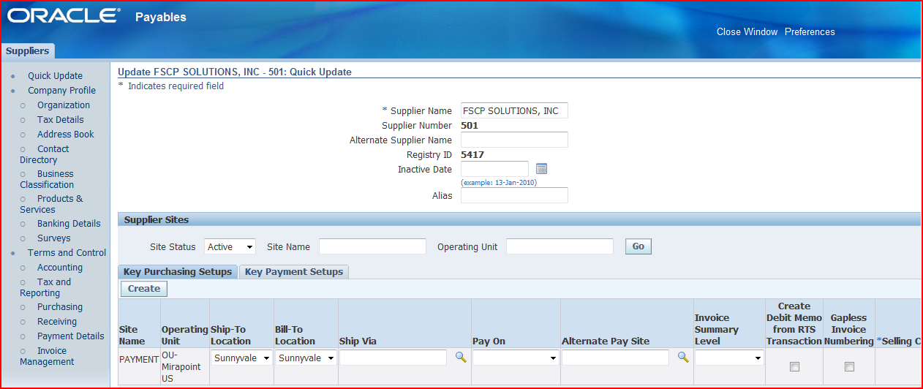
New Supplier Form
FSCP Solutions Inc.

Slide 33
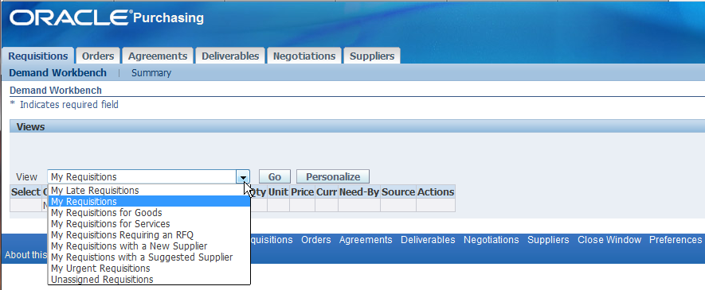
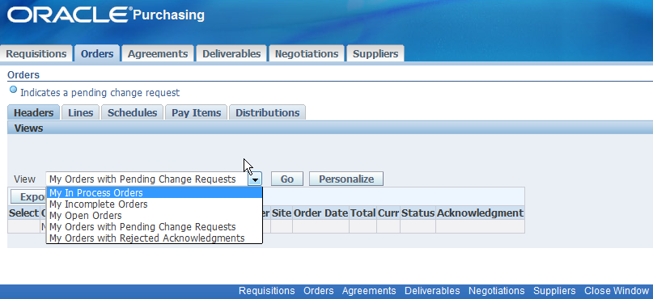
Purchasing
FSCP Solutions Inc.
Unified work center for procurement

Slide 34
Accruals
FSCP Solutions Inc.
Accrual accounting and processing is part of Cost Management
Accrual processing and reports used for accrual have changed
Write-offs now create accounting entries
Receiving and Expense Accruals are listed as coming from Cost Management
  In releases prior to 12.06, you need to make setup changes to auto reverse the expense accrual entry in GL, now automatic
Detail and Summary reporting for perpetual accruals

Slide 35
Contract Purchases - Improvements
FSCP Solutions Inc.
Contract based purchase orders are now possible
  Allows withholding payments based on percentages set on a PO (Recoupment Rate)
  These are decided as part of the contract when the PO was initiated
  Progress payments are possible, these invoices are matched to the PO updating progress
  Also manages complex financing (Progress Payment Rate)

Slide 36
Bills of Material, WIP & Cost Mgmt
FSCP Solutions Inc.
Cost Management now manages all Receiving, Inventory & WIP accounting
Fixed Component Usage Support
  Support for lot-based materials that have a fixed usage regardless of the job size for discrete WIP jobs, OSFM lot-based jobs and Flow Manufacturing
  This feature is not supported in Standard MRP or Standard Supply Chain Planning. This enhancement is only available with ASCP (Advanced Supply Chain Planning)
Component Yield Support
  Flexibility to control the value of component yield factors at WIP job level. The transaction logic now considers pre-yield BOM quantity per assembly rather than the quantity inflated by shrinkage.

Slide 37
Chargeable Subcontracting
FSCP Solutions Inc.
Support for Chargeable Subcontracting
  Chargeable Subcontracting, (SHIKYU), is a concept used in Japan, Korea and Taiwan with subcontract manufacturers. )
Features across the Supply Chain products to support Chargeable Subcontracting
Ability to set up OEM and Mfg Partner Orgs
Related item and cost setups as well
Notes:
Chargeable Subcontracting (SHIKYU) is a concept used in Japan, Korea and Taiwan with subcontract manufacturers
On delivery of outsourced subassemblies any difference between current standard cost and outsourced subassemblies price is posted to a Chargeable Subcontracting Variance account instead of a Purchase Price Variance account

Slide 38
FSCP Solutions Inc.
Oracle Cost Management & SLA
Discrete - flexible variance accounting for:
  Invoice price and purchase variances
  Average cost adjustment
  Standard cost adjustment
  Manufacturing variances
  Account aliases
  Freight charges
  Most other inventory, manufacturing and related account entries
Process - the MAC has been replaced by SLA

Slide 39
Inventory
FSCP Solutions Inc.
Genealogy
The key enhancements
  Unified view of lot and serial number genealogy
  Genealogy of Lot Exclusivity
  Quality information as part of Genealogy Inquiry
  Supplier Lot Number in Genealogy Inquiry
  Lot number validation for component return
  Lot and Serial Genealogy Report
  CFR P Lot Number Length change - With the increase in inventory lot number from 30 characters to 80 characters

Slide 40
WIP - MES
FSCP Solutions Inc.
Discrete Execution Workstation
  Streamlined User Interface
  Job assignments, requirements, instructions and ability to monitor progress all in the same place
  Based on the user role, predefined security and preferences control the types of functions and information that each user of this workstation can access
  Dispatch list ─ a listing of all job operations that are in queue to be worked on for one particular resource, across multiple resources or departments, or an entire organization ─ as determined by parameter setups
  Streamlined lot and serial number entry
  Overall better exceptions reporting and resolution

Slide 41
Quality, Service, Field Service
FSCP Solutions Inc.
ERES capabilities have been extended the following 21 CFR Part critical events
  820.170 - Installation
  820.198 - Complaint files
  820.200 – Servicing
  To support these critical events, these events were added
    Service Request Approval to obtain approvals during different phases of the service request lifecycle
    Debrief Report for any completion of the field service or depot repair tasks.
    The ERES events for Oracle Quality in 11.5.10 have been re-used with enhancements to support deferred approvals

Slide 42
EAM – Item Attribution Changes
FSCP Solutions Inc.
EAM now has Transactable Asset Groups
Asset Group Item
  Allows Item to be Stockable and Transactable. (Previously Asset group Item could not be transactable)
This is HUGE for eAM users – allows you to transfer rebuildable assets to and from locations

Slide 43
FSCP Solutions Inc.
Period Close Diagnostics
Forms Drilldown
  Using the same Inventory Accounting Periods form you can drilldown to associated forms to view the problem transactions
New workflow to notify of failing transactions
Period Close Pending Transactions Report
  Report for the transactions holding up the inventory accounting period
  Inventory reconciliation reports have an as-of-date
  Subledger Period Close Exception Report
Notes:
The period close diagnostics tools have been improved to simplify the effort of accurately closing accounting periods for costing transactions. New tools are provided to highlight unprocessed transactions, and user can click drilldowns to the details of those transactions. This helps users identify and resolve these exception transactions quicker.
There is a new diagnostic report format in XML publisher that shows all transactions that are holding up period close.
And, users can setup alerts and notifications for real time notification of system errors.

Slide 44
Additional Information
FSCP Solutions Inc.
Metalink
  Subledger Accounting Setup & Usage FAQ's [ID 559064.1]
  Release Content Documents for E-Business Suite Release 12 and 12.0.x Release Update Packs [ID 404152.1]
  Best Practices for Adopting Oracle E-Business Suite, Release 12 [ID 580299.1]
  http://www.oracle.com/applications/financials/intro.html
  Oracle Payments Documentation Resources, R12 [ID 396083.1]
  Oracle Payments Release Notes, Release 12.1.1 [ID 812085.1]
  R12 Payments and Payment Reports 'How To' documents [ID 579132.1]
Various other sites –
  https://oracleerp.groupsite.com/main
  http://www.oracleappshub.com/
  http://realworldoracleapps.blogspot.com/
  https://mix.oracle.com/

Slide 45
Contact Information
Mohan Iyer
  mohan@fscpsolutions.com
  www.fscpsolutions.com
  408 859 4484
Over 20 years’ experience with Oracle Applications
Founder & Board Member GL-SIG
Past Board member of NorCalOAUG and MNSIG
Doug Volz
  doug@volzconsulting.com
  www.volzconsulting.com
  510 755 7050
  30 years Cost Experience
  Leading OAUG Cost Management SIG since 2007
  Cost and Accounting industry positions
  Co-Designed Oracle Cost Management
  International Consulting in 12 countries
  Project Management, Track Lead and SME positions

