Slide 1


Hitachi Consulting
Hindsite Overview & Demo

Slide 2
What Should I Do?
Migrate to
R12.1
Incorporate
Edge Apps
Enhance 11i
Wait…….
????
2
Notes:
Many clients are reaching out to us unsure about their next steps with Oracle EBS. With 11i Premier support and Extended support expiring over the next few years, many clients on 11i need to begin their Oracle R12 migration planning now. Hindsite is here to help you get started on the right path to an R12 migration
2

Slide 3










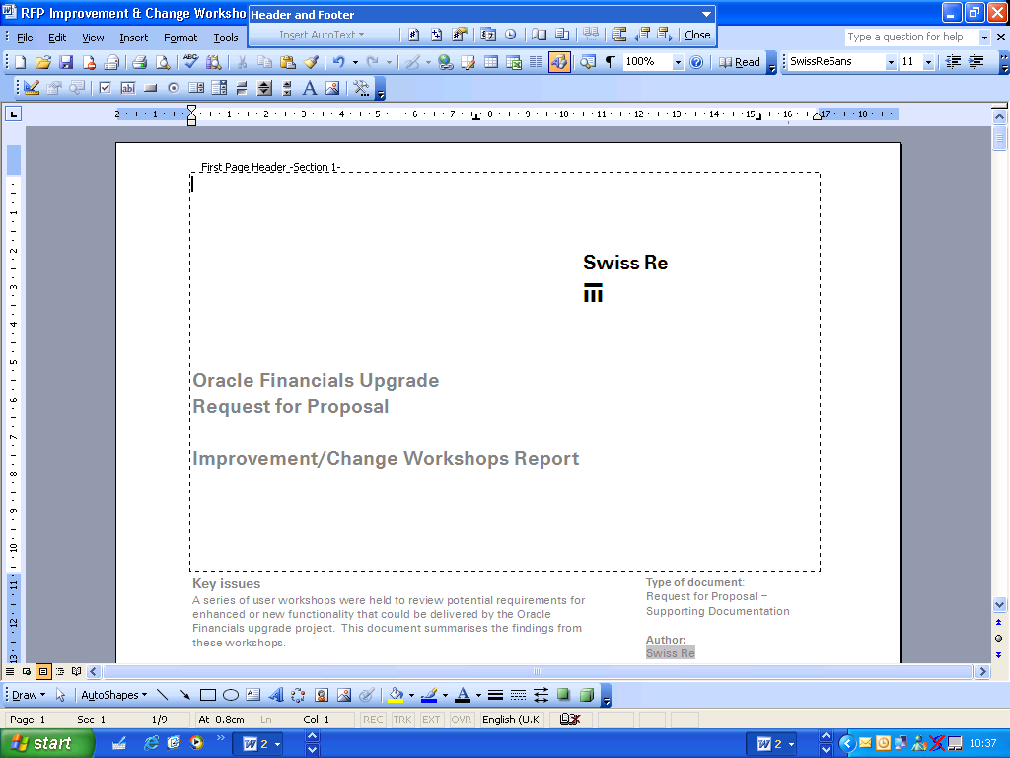








Evaluate & Scope an R12 Migration
What is Hindsite?
  Our Hindsite tool was developed to give clients a roadmap specifically designed for Oracle R12 Migrations
  Web Based Decision assessment tool with over 2,500 questions
  Technical and Functional Assessment of your current Oracle environment
  Detailed questionnaire asking about the functionality to be used in R12
  Helps clients define their scope and understand their complexities / risk
1 day assessment
Cost: $0
Notes:
Hindsite is a tool that will ask potential clients about their current business situation to help understand if they should go the upgrade vs. the re-implementation route. In addition, it will ask about their current state Oracle implementation, what customizations they have in place, ask about their technical architecture, and go through a detailed questionnaire about what functionality they want to use in R12.
The output includes:
A word document in the form of a project charter (scope, approach, risks, etc…).
A project plan using the Edenbrook methodology. We are not going to update the project plan and try to change it to HFusion tasks/phases.
We are also going to develop a power point presentation which will be a high level version of the project charter.
Hindsite does not accelerate the project and does not help with estimation. It provides cool output to get in the door with potential clients. It is a sales tool and not a delivery tool. It will ask a lot of questions in an organized / structured way. This will help our GTM teams approach potential clients more professionally.

Slide 4
R12 Upgrade vs. Re-Implementation
Upgrade
Lower Budget and time constraint
Smaller and more manageable change event
Re-Implement
Allows for BPR or enables org changes like SSC
Clean data during conversion
Allows for critical changes to COA, Calendar, costing method, etc
Current configurations map well with business processes
Instance consolidation is major objective
Customizations and integration to 3rd party systems can’t be replaced with R12
Notes:
One of the main features of Hindsite, is that based on our clients unique drivers and pain points, it provides a recommendation for their R12 migration. Should you be looking at the upgrade route or the re-implementation route. These are some of the questions that help direct you one way versus the other.

Slide 5

Hindsite Output
Project Charter
Scope & Risks
Potential Org Structure
Roles, Deliverables, Results
Executive Presentation
Summary of Functional & Technical Scope outlining Upgrade v. Reimplementation Results
Modeler
Interactive spreadsheet, allows users to model upgrade versus re-implementation
Project Plan
MS Project Plan including tasks, resources, dates and level of effort for upgrade
Notes:
Moved this slide up to #3 bc in the script, you move from talking about slide #2, into what is Hindsite and what is the output – then you go into where we have performed and used Hindsite at our clients - Rather than listing these docs, can we illustrate them with pictures? I would add the logo for Hindsite as the input, then 4 pics, one for each category of output, labeled as such, remove descriptions and talk to them
Here are the bullets that describe Hindsite and its output
Web based planning tool to provide an assessment and high level direction to R12 migrations (over 2,000 question)
Quickly understand if your business drivers tend towards a new re-implementation, upgrade, or postpone
Captures requirements across all modules of Oracle R12
Automatically generates a project charter, power point summary report, project plan, and modeler tool in Excel
Project Charter – Word document describing project scope and risks. Also describes potential org structure, roles, deliverables, and results of Upgrade vs. Reimplementation questions.
Presentation – Power Point presentation summarizing functional scope, technical scope, and R12 Upgrade vs. Reimplementation results
Modeler: Upgrade vs. Reimplementation – Excel spreadsheet showing results of the Upgrade vs. Reimplement analysis. Allows clients to modify answers and see how they impact the Upgrade vs. Reimplement approach.
Project Plan – MS project plan output and algorithm used to generate tasks, resources, dates, and LOE. (what is LOE?)

Slide 6

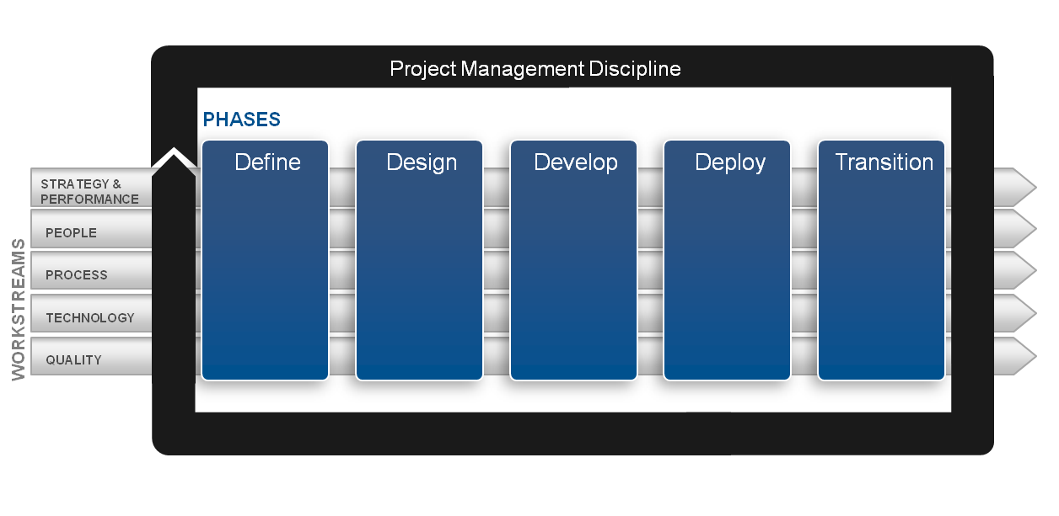

Migration Process – How Hitachi Consulting Can Help
Evaluate & Scope Migration
Take Action!
Get started with an upgrade planning tool to provide a high level direction
Quickly understand if your business drivers tend towards a new re-implementation, upgrade, or postpone
Technical, functional and business process workshops
Leverage proven project methodology that includes Oracle Unified Method (OUM)
Upgrade tools to expedite migration
Solutions to transform business structure setups to target structure
Oracle Business Accelerators and industry process flows

Slide 7
Hindsite
DEMO

Slide 8
Questions?
Our Hindsite tool was developed by Hitachi Consulting to give our clients a high level assessment specifically designed for Oracle R12 migrations
For more information or to schedule a Hindsite demo, contact:
Marc Feinberg
818.219.2841
mfeinberg@hitachiconsulting.com
Mario Montag
678.576.5673
mmontag@hitachiconsulting.com
Notes:
Wanted the last sentence to be specific

